Slide 1
Pill-Box

Slide 2

IMPROVING HEALTHCARE USING SMART PILL BOX FOR MEDICAL REMINDER
Indian Institute of Information Technology-Dharwad
Under Guidance of:
Dr .Uma S

Slide 3
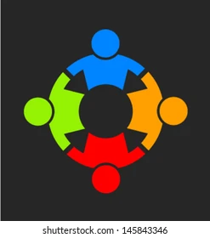
Submitted By:
Bhargava H.S (18BCS018)
Palshini B (18BCS062)
Raghu Prasad J N (18BCS073)
Vivek S (18BCS111)

Slide 4
INTRODUCTION
There can be a lot of individuals out there who need constant help may it be our elderly people, family members, the ones who have special needs. Elders are more affected by the timing of taking a certain drug than others, in order to prevent any dysfunction or illness timing is a must.
Some people may forget to take the medicines at the correct time and can forget the medicines which they have to take. In order to eliminate the factors of always needed observation like nurses or taking a risk of a missed dose, we had to find an easy, portable and efficient solution.
n order to make a really useful smart pillbox it had to be easily integrated with the recent sweeping smart technologies.

Slide 5
Abstract
Many medical errors are due to the fact that people in charge of patient or elder's medication have to deal with sorting huge amounts of pills each day.
This medication pill box is focused on patients who frequently take medications or vitamin supplements, or attendants who deal with the more seasoned or patients.
Our smart pill box is programmable that enables medical caretakers or clients to determine the pill amount and timing to take pills, and the service times for every day.
The pillbox will remind clients or patients to take pills utilizing sound and light. The warning of pills should be taken will be shown by an android application which is held by the patient.

Slide 6
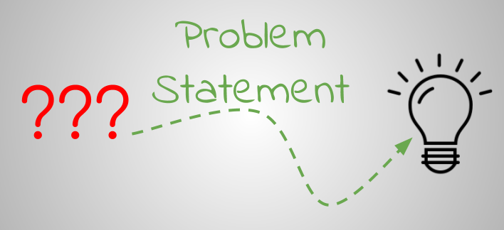

Slide 7
As pills have taken such an important role in everyday life there has been the past years an increase in the number of medical neglect cases related to incorrect medication given to patients,
Several problems related to the high amount of pills nowadays are prescribed to patients are found in hospitals or in retirement homes. In these places one of the main jobs is to give out to its patient the correct pills. Managing, sorting and giving out the pills to each one of the patients can sometimes have a high chance of error, with a patient or resident receiving one or more incorrect pills.
Finally there are situation where taking an incorrect amount of pills is a matter of the patient's inexperience and/or ignorance. No matter the cause, it has been proven that there is a significant risk of people ending up swallowing the incorrect medication or dose.

Slide 8
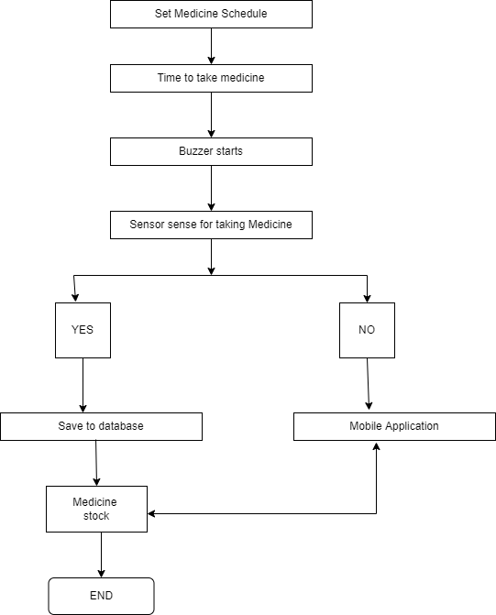
Block Diagram

Slide 9

Working Model !!

Slide 10
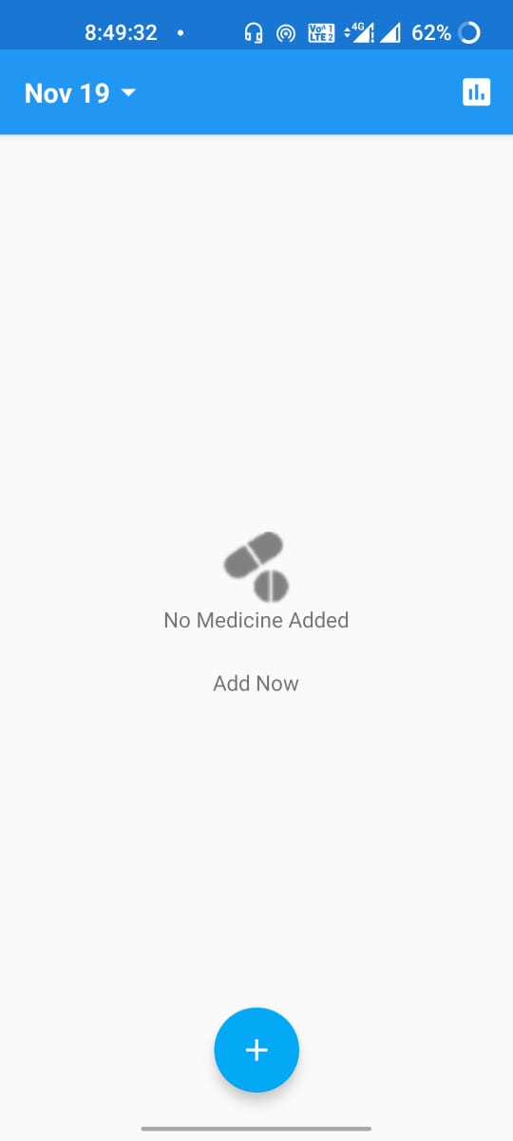
Main page of our
Application

Slide 11
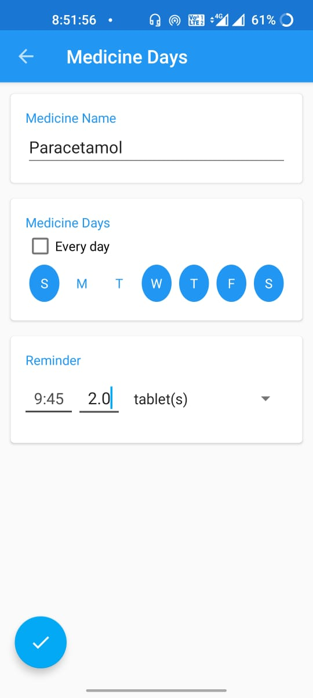
Adding Medicine
We are adding the medicine and setting the time at which the medicine should be taken ,and also the number of doses.

Slide 12
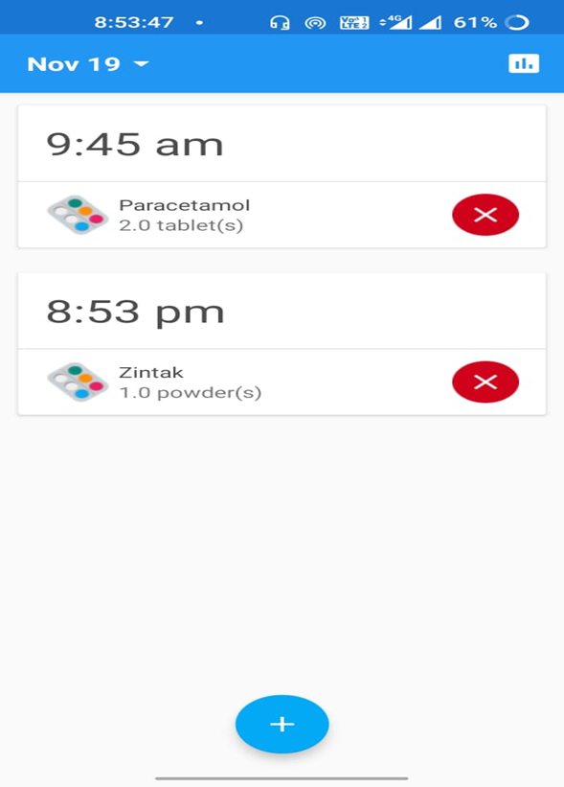
Medicines List
Showing the list of medicines added ,we can add and delete the medicines which we want.

Slide 13
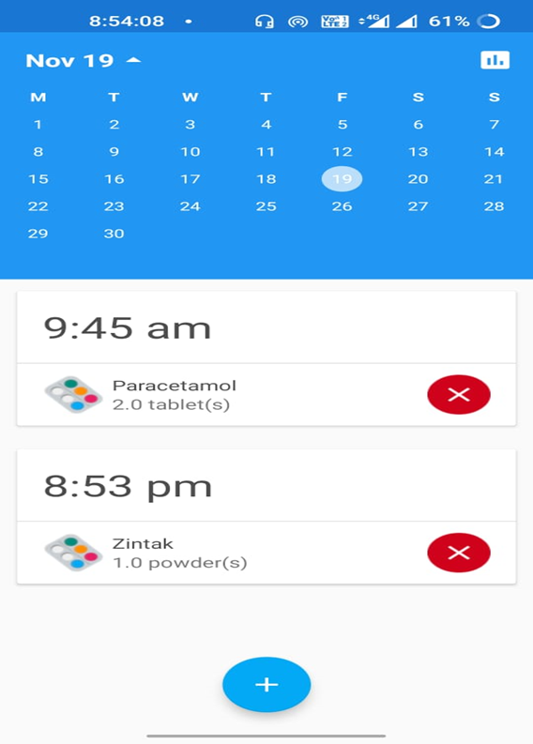
Scheduling
We can schedule the medicines according to the calendar.

Slide 14
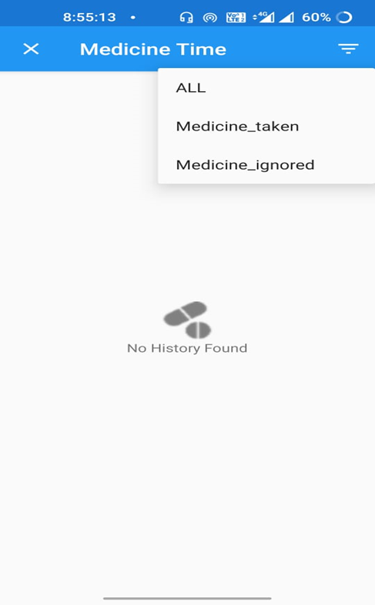
Medicine Record
This shows the record of medicines taken and medicines ignored. Initially, since we haven’t fed any data to the application, therefore it shows ‘No History Found’.

Slide 15
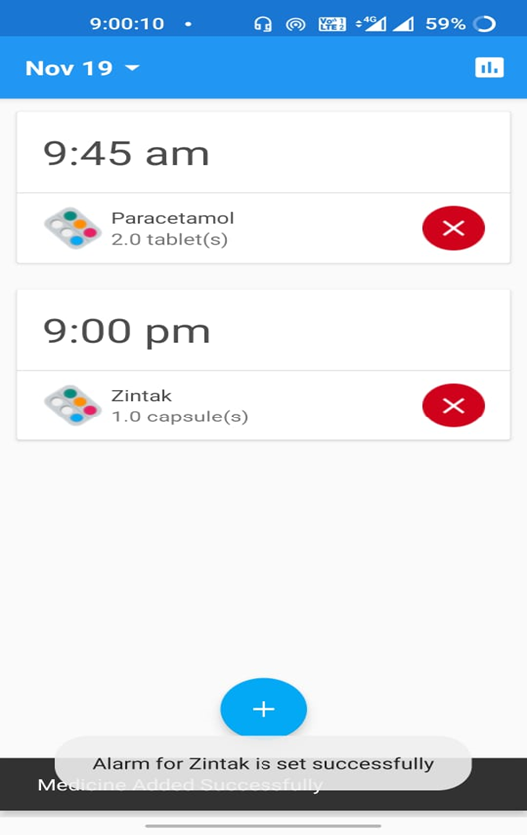
Alarm
After adding the medicine the alarm will be set.

Slide 16

.
INNOVATIVE PART

Slide 17
The data stored in the App will be stored in the Database where we can get the medical records of a particular patients ,so it will be helpful in monitoring the patient .

Slide 18


Slide 19
People who don’t remember to take the medicine on time it can be good reminder
For old age people it will be more beneficial
Alzheimer's patient
At big hospitals the care takers of patient will be having no confusion at what time the patients should get medicine

Slide 20
Conclusion
The aim of this study is to build a Smart Pill Box for Medicine Reminder and Monitoring System. When the pill time has been set, the pillbox will remind clients or patients to take pills utilizing sound and light. The warning of pills should be taken will be shown by an android application which is held by the patient. Contrasted and the conventional pill box that requires clients or attendants to stack the crate each day or consistently. This model can aid in help elders to take their medication.

Slide 21

THANKS!

